Slide 1

Mini Project On
Question Paper Generator using Python
For the subject of Microprocessors
as part of AAT for CIE
Under Guidance of
Mr. Anil Sagar T
Asst. Professor
Dept. of Computer Science
Dayananda Sagar College of Engineering
By
Aditya (1DS16CS009)
Devansh Sharma (1DS16CS032)
Harsh Pyati (1DS16CS035)
Department of Computer Science & Engineering, DSCE

Slide 2
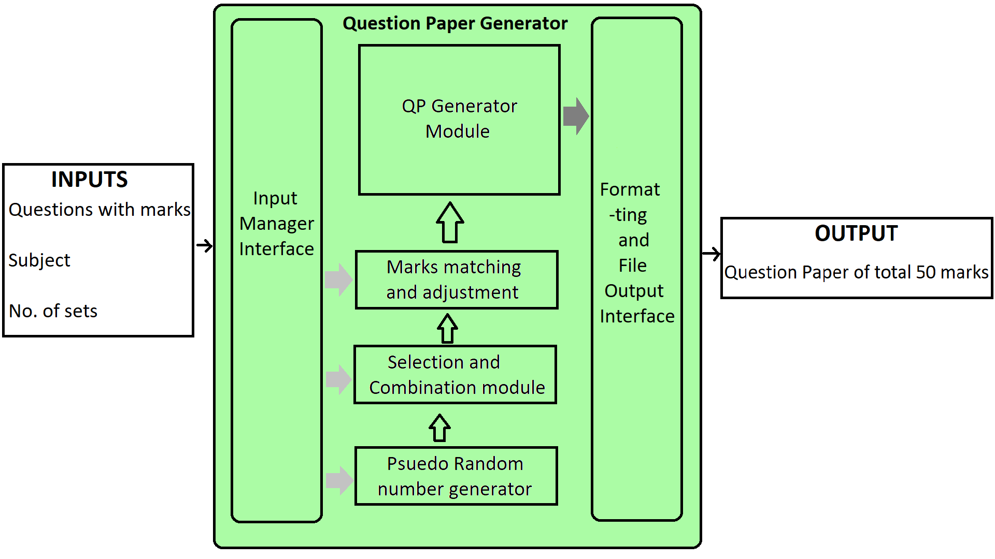
Block Diagram
CO List
Department of Computer Science & Engineering, DSCE

Slide 3
Software/Modules Used
Python 3.4 or above
Tkinter 8.6 or above
Reportlab 3.4
Department of Computer Science & Engineering, DSCE

Slide 4
Objectives
To generate one or more question papers in a pdf format by randomly selecting questions from a .txt file encoded with a particular syntax. The total marks for a question paper is 50.
Export generated question paper(s) to the computer running the program in a folder.
Provide a GUI to select questions file, select the number of sets, optional Course Objectives list file and select an export location.
Department of Computer Science & Engineering, DSCE

Slide 5
Methodology
Provide a GUI to select the questions file and the number of sets
Once the required parameters are selected, the input module calls the the paper generator
The paper generator works as such:
Generates a psuedo-random number limited to the number of questions in the file provided.
Selects the corresponding question and marks it as added. Copies the question to the output file and updates total marks.
Once the total marks is >43 (85%), the selection of questions is limited to 50-total marks.
The generated paper is rendered as pdf and exported
The above process is repeated for the required number of sets.
Department of Computer Science & Engineering, DSCE

Slide 6
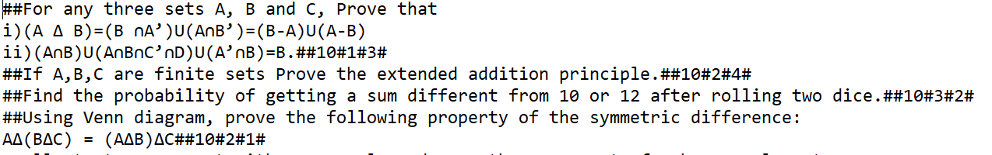
Input File
Questions File:
Course Objectives File:
Department of Computer Science & Engineering, DSCE

Slide 7
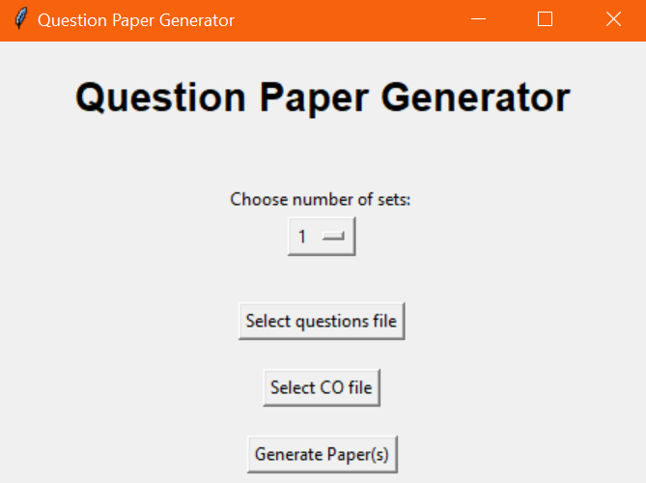
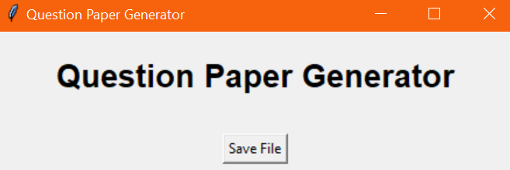
GUI
Department of Computer Science & Engineering, DSCE

Slide 8
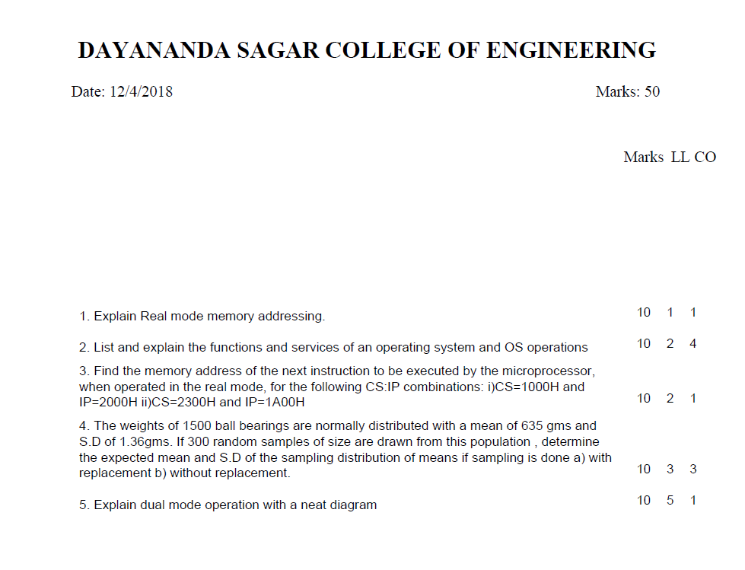
Output File
Department of Computer Science & Engineering, DSCE

Slide 9
Other Possible Applications
By using sentences instead of questions and with a few modifications and integration with a dictionary, mad libs templates can be generated
Combining this algorithm with other algorithms, crossword puzzles may be created.
MCQ papers, fill in the blank type papers and other types of papers can be made with modifications.
Department of Computer Science & Engineering, DSCE

Slide 10
Thank You
Department of Computer Science & Engineering, DSCE

